Slide 1

By The KAVDA Team
(KEVIN FRIDAY, ANJULI TUCK, VANESSA MALDONADO,DANIEL ESCOBEDO, & ALBALICIA ESPINO)

Slide 2
Imagine A World Free Of Central Monetary Control…
Notes:
KEVIN SPEAKING

Slide 3

Concept
User Story
Description
Our app caters to users who are taking their first steps to understand cryptocurrency, so they can invest wisely for the future.
Motivation For Development
Real Life Tool
Passion Project
Promote Defi
As A stock exchange user
I WANT to become educated on cryptocurrency
SO THAT I can invest in the crypto market
Notes:
KEVIN SPEAKING

Slide 4
Acceptance Criteria
WHEN THE USER CLICKS ON THE CRYPTO DROPDOWN
THEN THE TOP 5 CRYPTOCURRENCIES: BITCOIN, ETHEREUM, BINANCE, SOLANA, XRP CAN BE SELECTED.
WHEN THE USER SELECTS A CRYPTOCURRENCY FROM THE DROPDOWN
THEN THE FOLLOWING INFORMATION WILL BE DISPLAYED: PERCENT CHANGE IN 24H, PRICE CHANGE IN 24H, MARKET CAP, CURRENT PRICE.
WHEN THE USER CLICKS ON THE STOCK MARKET DROPDOWN
THEN THE TOP 5 STOCKS: Tesla, Meta, Google, Apple Amazon CAN BE SELECTED.
WHEN THE USER SELECTS A STOCK
THEN THE FOLLOWING INFORMATION WILL BE DISPLAYED: PERCENT CHANGE IN 24H, PRICE CHANGE IN 24H, MARKET CAP, CURRENT PRICE.
WHEN THE USER SELECTS FROM THE DROPDOWN
THEN IT WILL GENERATE THE INFORMATION PERTAINING TO THE CURRENCY SELECTED.
Notes:
ALBALICIA SPEAKING

Slide 5
Process
Tasks Breakdown
Discuss App Ideas
Research APIS & Weigh Pros & Cons
Group Vote
Create User Story & Acceptance Criteria
Build Wireframe
Code HTML & CSS (Bulma)
Code Javascript
Merge Branches & Resolve Conflicts
README & Presentation Prep
Roles
Wireframe: Everyone
API Research: Everyone
User Story: Everyone
HTML & CSS: Anjuli & Albalicia
Javascript: Kevin & Vanessa & Daniel
Brand Identity: Anjuli
Merging: Everyone
Technologies Used:
HTML
Bulma
Javascript
Finn Short - Stock API
Coin Gecko - Cryptocurrency API
Crypto News Live - Crypto News API ( COMING SOON)
Notes:
JULI SPEAKING

Slide 6
Process Cont.
Challenges
Finding Free Stock APIs
Some APIs Were Free Until A Certain Amount Of Requests
Some require Node or run into CORS issues
APIs Missing Info
Installing SASS To Customize Bulma Elements
Issues with Path Errors & CSS Generation
Parsing Data API
HARD SHIT!
Successes
Parsing Data API
Love Bulma More Than Bootstrap
Simple, Concise Documentation
Responsive
Working In Branches
Debugging Together
Everyone Is More Confident In Their Abilities
Agile Development + Teamwork!
Consistent Communication
Meetups Everyday
Asked For Help (ie. Victor, tutors)
Notes:
JULI SPEAKING

Slide 7
READY TO GO TO THE MOON?
TITLE HERE
ABOUT | COMPARE | CRYPTO INFO
IMAGE
Cryptocurrency can be intimidating, we are here to help you dive in with the basics of crypto and comparing top stock market values against cryptocurrency.
…so you too can go to the moon.
Here are the top terms you should know:
<terms here>
Notes:
DANIEL + VANESSA SPEAKING

Slide 8
COMPARE
TOP 5 CRYPTOCURRENCY DROPDOWN
TOP 5 STOCK MARKET DROPDOWN
PERCENT CHANGE IN 24H, PRICE CHANGE IN 24H, MARKET CAP, CURRENT PRICE
PERCENT CHANGE IN 24H, PRICE CHANGE IN 24H, MARKET CAP, CURRENT PRICE
EDUCATION
CRYPTO EDUCATION
CRYPTO NEWS
FOOTER
Notes:
DANIEL + VANESSA SPEAKING

Slide 9
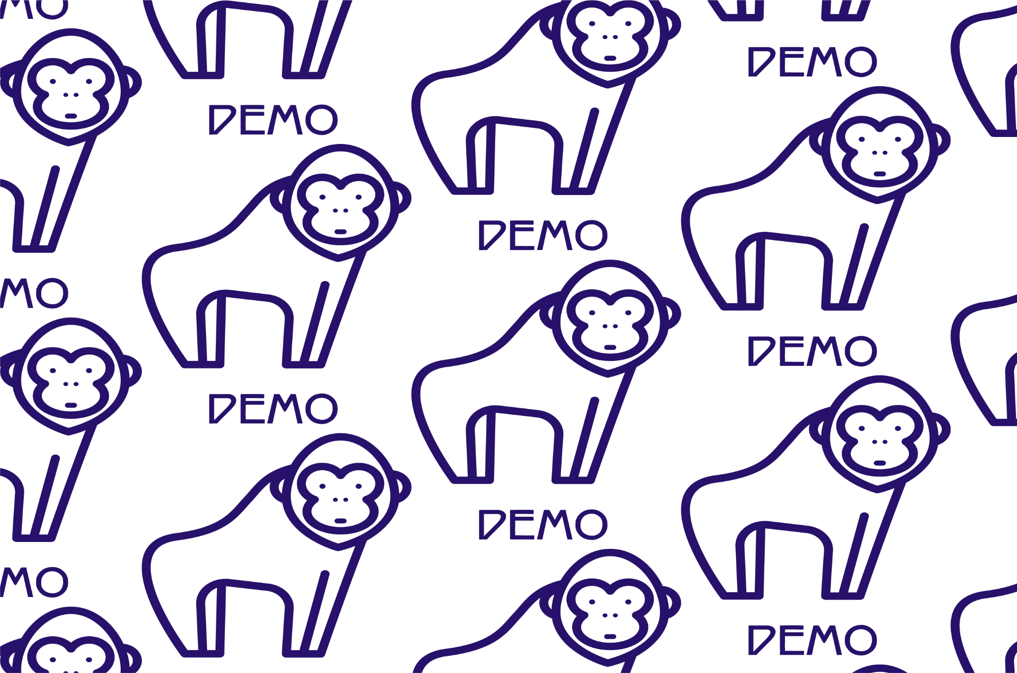
Notes:
KEVIN + VANESSA SPEAKING

Slide 10
Future Development
Install SASS To Create Bulma Customizations For Cohesive Visual Design
Integrate Crypto Education & News API
Add Advertisers (ie.Voyager,CoinBase, Kraken, etc.)
Open Up Web3 To Add Crypto Wallet Integration
Create Mobile-Friendly App
Expand On Cryptocurrency Data & Stock Information
Notes:
KEVIN SPEAKING

Slide 11

Links
Thanks For The Help!
TA-Victor
TA-Ethan
Tutors
Kevin For Javascript ❤️
Vanessa For Event Listeners ❤️
Juli - Group Leader 🧐
Albalicia - Biggest Improvement 💪🏼
Daniel - API Researcher 💻
Deployed: https://drkevinfriday.github.io/Hold-On-for-Dear-Life-Ape/
REPO: https://github.com/drkevinfriday/Hold-On-for-Dear-Life-Ape.git
Notes:
DANIEL + JULI SPEAKING

